Slide 1
GH-100: GitHub Fundamentals - Administration basics and product features Part 1
GitHub Fundamentals - Administration basics and product features
- Part 1
Notes:
https://learn.microsoft.com/en-us/training/paths/github-administration-products/

Slide 2
Module 1: Introduction to GitHub
Module 1: Introduction to GitHub
Notes:
Title: Module 1: Introduction to GitHub
Learning Objectives:
By the end of this unit, you'll be able to:
Identify the fundamental features of GitHub.
Learn about repository management.
Gain an understanding of the GitHub flow, including branches, commits, and pull requests.
Explore the collaborative features of GitHub by reviewing issues and discussions.
Recognize how to manage your GitHub notifications and subscriptions.
Module Units
Introduction 2 min
What is GitHub? 8 min
Components of the GitHub flow 8 min
GitHub is a collaborative platform 8 min
GitHub platform management 4 min
Exercise - A guided tour of GitHub 58 min
Module assessment 3 min
Summary 1 min

Slide 3
Introduction
GitHub provides an AI-powered developer platform to build, scale, and deliver secure software. Whether you’re planning new features, fixing bugs, or collaborating on changes, GitHub is where over 100 million developers from across the globe come together to create things and make them even better.
By the end of this unit, you'll be able to:
Identify the fundamental features of GitHub.
Learn about repository management.
Gain an understanding of the GitHub flow, including branches, commits, and pull requests.
Explore the collaborative features of GitHub by reviewing issues and discussions.
Recognize how to manage your GitHub notifications and subscriptions.
Notes:
In this unit, we’re diving into GitHub—an AI-powered developer platform that over 100 million developers worldwide use to build, scale, and deliver secure software. Whether it’s planning new features, squashing bugs, or collaborating on the next big release, GitHub is at the heart of it all.
Over the next few minutes, you’ll get hands-on experience inside a GitHub repository, so you can see these features in action.
The goal is to make you feel comfortable navigating GitHub’s core functionality, and by the end, you’ll walk away knowing exactly where to go and what to do, every time you need to work on code together.

Slide 4
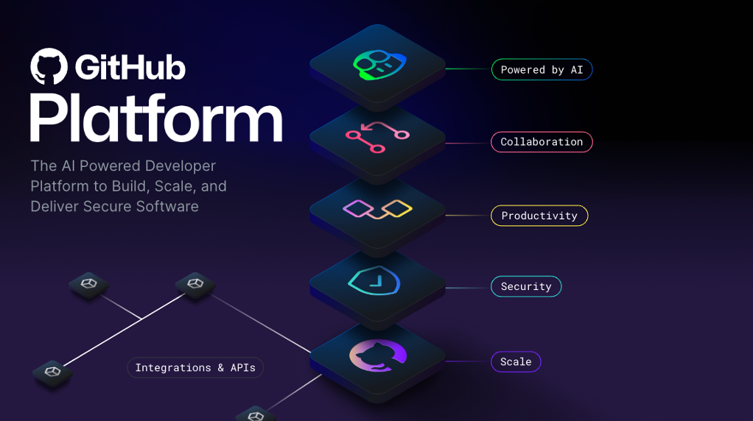
What is GitHub?
GitHub is a cloud-based platform that uses Git, a distributed version control system, at its core. The GitHub platform simplifies the process of collaborating on projects and provides a website, command-line tools, and overall flow that allows developers and users to work together.
As we learned earlier, GitHub provides an AI powered developer platform to build, scale, and deliver secure software.
Let’s break down each one of the core pillars of the GitHub Enterprise platform, AI, Collaboration, Productivity, Security, and Scale.
Notes:
At its core, GitHub is a cloud-based platform built on Git, the industry-standard distributed version control system.
You can think of GitHub as a toolkit plus a community hub—it gives you a web interface, a command-line experience, and an overall workflow designed so teams can collaborate seamlessly.
Whether you’re pushing code, reviewing a pull request, or opening an issue, GitHub handles the heavy lifting of versioning and collaboration, so you can focus on writing great software.
On the right, you see a layered diagram of the GitHub platform. From bottom to top, it’s organized into five pillars:
Scale – the infrastructure that keeps GitHub fast and reliable, even as your organization grows
Security – features like code scanning and secret detection that help you ship safely
Productivity – tools such as code review, automation, and project boards to keep work moving
Collaboration – pull requests, issues, and discussions that let teams work in concert
AI – intelligent suggestions and automation powered by machine learning to accelerate your workflow
We’ll unpack each of these in a moment, so you understand not just what GitHub does, but how it supports your entire development lifecycle.

Slide 5
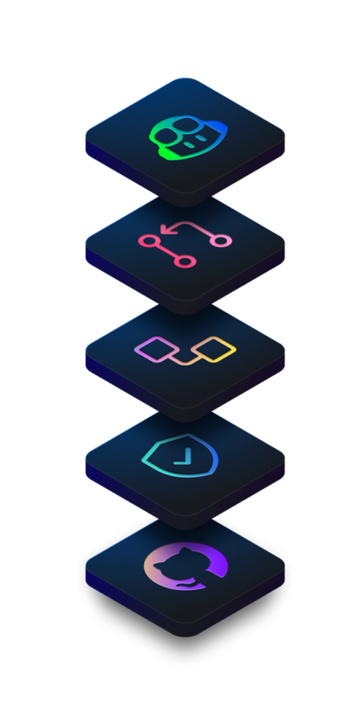
The GitHub Enterprise Platform
Generative AI is dramatically transforming software development as we speak. The GitHub Enterprise platform is enhancing collaboration through AI-powered pull requests and issues, productivity through Copilot, and security by automating security checks faster.
© Copyright Microsoft Corporation. All rights reserved.
Notes:
Let’s start at the top: Generative AI.
Right now, AI is revolutionizing how we write, review, and secure code.
On GitHub Enterprise, AI powers pull-request suggestions and automated issue triage, so you spend less time on the mundane. Copilot helps you draft code snippets in real time, and behind the scenes AI runs security checks at machine speed—uncovering vulnerabilities before they ever reach production.
It’s like having an intelligent teammate who never misses a detail.

Slide 6
The GitHub Enterprise Platform
Collaboration is at the core of everything GitHub does. We know inefficient collaboration results in wasted time and money. We counteract that with a suite of seamless tools that allow collaboration to happen effortlessly.
Repositories, Issues, Pull Requests, and other tools help to enable developers, project managers, operation leaders, and others at the same company. It enables them to work faster together, cut down approval times, and ship more quickly.
© Copyright Microsoft Corporation. All rights reserved.
Notes:
Collaboration is really GitHub’s heartbeat.
We all know that poor collaboration costs time—and money.
That’s why GitHub bundles tools like Repositories, Issues, and Pull Requests into one seamless experience.
Whether you’re a developer, project manager, or operations lead, these features let you comment, assign, and track work without context switching.
The result?
Faster approvals, tighter feedback loops, and shipping more features, more often.

Slide 7
The GitHub Enterprise Platform
Productivity is accelerated with automation that the GitHub Enterprise Platform provides. With built-in CI/CD (Continuous Integration and Continuous Delivery) tools directly integrated into the workflow, the platform gives users the ability to set tasks and forget them, taking care of routine administration and speeding up day-to-day work. This gives your developers more time to focus on what matters most, creating innovative solutions.
© Copyright Microsoft Corporation. All rights reserved.
Notes:
Next up: Productivity.
GitHub’s built-in CI/CD pipelines via GitHub Actions mean you can ‘set it and forget it.’
Once you define workflows—whether running tests, deploying to staging, or notifying Slack—GitHub takes care of the rest.
This automation frees your team from repetitive tasks so they can focus on the fun stuff: designing, coding, and innovating.

Slide 8
The GitHub Enterprise Platform
GitHub focuses on integrating security directly into the development process from the start. GitHub Enterprise platform includes native, first-party security features that minimize security risk with a built-in security solution. Plus, your code remains private within your organization. At the same time, you're able to take advantage of security overview and Dependabot.
GitHub has continued to make investments to ensure that our features are enterprise-ready. Microsoft and highly regulated industries trust GitHub, and we meet global compliance requirements.
© Copyright Microsoft Corporation. All rights reserved.
Notes:
Security isn’t an afterthought on GitHub—it’s baked in.
With first-party features like Dependabot alerts, code-scanning, and secret management, you catch risks early in the development process.
Everything stays private within your organization, yet you benefit from enterprise-grade compliance and audit logs.
That’s why Microsoft and highly regulated industries trust GitHub for mission-critical projects.

Slide 9
The GitHub Enterprise Platform
GitHub is the largest developer community of its kind with real-time data on over 100M+ developers, 330M+ repositories, and countless deployments. We’ve been able to understand the shifting needs of developers and make changes to our product to match.
This has translated into an incredible scale that is unmatched and unparalleled by any other company on the planet. Everyday we're gaining more insights from this impressive community and evolving the platform to meet their needs.
In essence, the GitHub Enterprise Platform focuses on the developer experience. It has the scale to provide industry-changing insights, collaboration capabilities for transformative efficiency, the tools for increased productivity, security at every step, and AI to power it all to new heights in a single, integrated platform.
Now let’s get into the backbone of GitHub, repositories.
© Copyright Microsoft Corporation. All rights reserved.
Notes:
Finally, let’s talk Scale.
GitHub hosts over 100 million developers and 330 million repositories—an ecosystem like no other.
This massive scale gives us real-time insights into how teams work, which drives continuous product improvements.
As your organization grows, GitHub grows with you, offering the performance and reliability you need to support codebases of any size.
You’ve now seen how AI, collaboration, productivity, security, and scale mesh together in GitHub Enterprise.
Next, we’ll dive into the backbone of it all—repositories.

Slide 10
What is a repository?
A repository contains all of your project's files and each file's revision history. It's one of the essential parts that helps you collaborate with people. You can use repositories to manage your work, track changes, store revision history, and work with others. Before we dive too deep, let’s first start with how to create a repository.
How to create a repository
You can create a new repository on your personal account or any organization where you have sufficient permissions.
Let’s tackle creating a repository from github.com.
Notes:
When you think ‘repository,’ imagine a smart folder that not only holds all your project’s files but also remembers every change ever made.
That history is what lets teams collaborate without fear—if something breaks, you can always roll back.
Repos are the foundation of everything we do on GitHub: tracking work, coordinating changes, and keeping projects organized.
Let’s make one now!

Slide 11
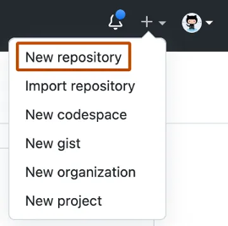
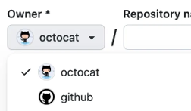
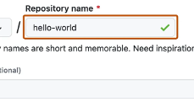
How to create a repository
Step 1
Step 2
Step 3
In the upper-right corner of any page, use the drop-down menu, and select New repository.
Use the Owner drop-down menu to select the account you want to own the repository.
Use the Owner drop-down menu to select the account you want to own the repository.
Notes:
Go to github.com and click the + icon in the top-right, then choose New repository.
In the Owner dropdown, pick your personal account or an organization where you have rights.
Give it a clear, concise Name (and an optional Description so others know what it’s for).

Slide 12
How to create a repository (continued)
Step 4
Step 5
Choose a repository visibility.
Public repositories are accessible to everyone on the internet.
Private repositories are only accessible to you, people you explicitly share access with, and, for organization repositories, certain organization members.
Select Create repository and congratulations! You just created a repository!
Next up, let’s review how to add files to your repository.
Notes:
Choose Public if you want anyone to see it, or Private to restrict access to just you and invited collaborators.
Click Create repository—and just like that, your new repo is ready.

Slide 13
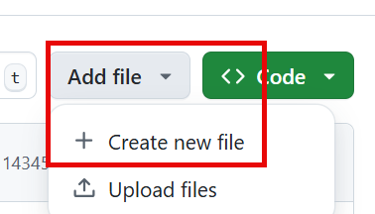
How to add a file to your repository
Files in GitHub can do a handful of things, but the main purpose of files is to store data and information about your project. It's worth knowing in order to add a file to a repository that you must first have minimum Write access within the repository you want to add a file.
Let’s review how to add a file to your repository.
Step 1
Step 2
Step 3
On GitHub.com, navigate to the main page of the repository.
In your repository, browse to the folder where you want to create a file by selecting the creating a new file link or uploading an existing file.
Once added, above the list of files select the Add file ᐁ drop-down menu. Then select Create new file.
Notes:
Now that your repo exists, let’s add content:
Before we begin, make sure you have Write access to the repository where you want to add a file. Without the right permissions, you won’t see the ‘Add file’ options.
On GitHub.com, navigate to the main page of the repository.
In your repository, browse to the folder where you want to create a file by selecting the creating a new file link or uploading an existing file.
Once added, above the list of files select the Add file ᐁ drop-down menu. Then select Create new file.

Slide 14
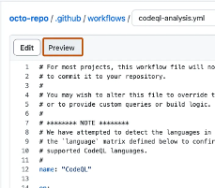
How to add a file to your repository (continued)
Step 4
Step 5
Step 6
In the file name field, type the name and extension for the file. To create subdirectories, type the / directory separator.
In the file contents text box, type content for the file.
To review the new content, above the file contents, select Preview.
Step 7
Step 8
Select Commit changes.
In the Commit message field, type a short and meaningful commit message that describes the change you made to the file. You can attribute the commit to more than one author in the commit message.
Notes:
In the file name field, type the name and extension for the file. To create subdirectories, type the / directory separator.
In the file contents text box, type content for the file.
To review the new content, above the file contents, select Preview.
Select Commit changes.
In the Commit message field, type a short and meaningful commit message that describes the change you made to the file. You can attribute the commit to more than one author in the commit message.

Slide 15
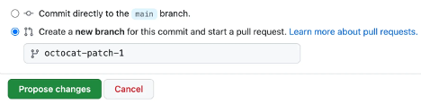
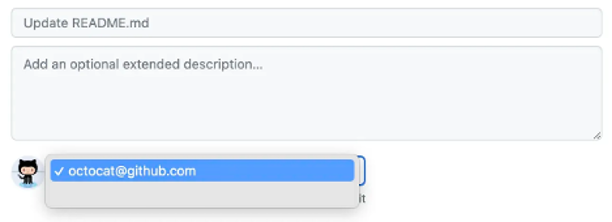
How to add a file to your repository (continued)
Step 9
Step 10
If you have more than one email address associated with your account on GitHub.com, select the email address drop-down menu. Then select the email address to use as the Git author email address. Only verified email addresses appear in this drop-down menu. If you enabled email address privacy, then [username]@users.noreply.github.com is the default commit author email address.
Below the Commit message fields, decide whether to add your commit to the current branch or to a new branch. If your current branch is the default branch, you should choose to create a new branch for your commit, and then create a pull request.
Notes:
If you have more than one email address associated with your account on GitHub.com, select the email address drop-down menu. Then select the email address to use as the Git author email address. Only verified email addresses appear in this drop-down menu. If you enabled email address privacy, then [username]@users.noreply.github.com is the default commit author email address.
Below the Commit message fields, decide whether to add your commit to the current branch or to a new branch. If your current branch is the default branch, you should choose to create a new branch for your commit, and then create a pull request.

Slide 16
How to add a file to your repository (continued)
Step 11
Select Commit changes or Propose changes.
Congratulations, you just created a new file in your repository! You have also created a new branch and made a commit.
Before we review branches and commits in the next unit, let’s quickly review gists, wikis, and GitHub pages because they're similar to repositories.
Notes:
11. Select Commit changes or Propose changes.
And that’s it—you’ve just added a brand-new file to your repository, complete with history and (if you chose) a pull request for collaboration. Great work!
Next, let’s quickly review gists, wikis, and GitHub pages because they're similar to repositories.

Slide 17
What are gists?
Now that we have a good understanding of repositories, we can review gists. Similarly to repositories, gists are a simplified way to share code snippets with others.
Every gist is a Git repository, which you can fork and clone and be made either public or secret. Public gists are displayed publicly where people can browse new ones as they’re created. Public gists are also searchable. Conversely, secret gists aren't searchable, but they aren’t entirely private. If you send the URL of a secret gist to a friend, they'll be able to see it.
To learn more about gists, see the linked article in our Resources section at the end of this module titled Creating Gists.
What are wikis?
Every repository on GitHub.com comes equipped with a section for hosting documentation, called a wiki. You can use your repository's wiki to share long-form content about your project, such as how to use it, how you designed it, or its core principles. While a README file quickly tells what your project can do, you can use a wiki to provide additional documentation.
It’s worth a reminder that if your repository is private, only people who have at least read access to your repository will have access to your wiki.
Notes:
Next up are Gists—think of them as mini-repositories for sharing bite-sized pieces of code or text. Each gist behaves just like a full Git repo: you can fork it, clone it locally, and track revisions.
You can make your gist public, which means it shows up in the global gist directory and is searchable by anyone. Or choose secret if you’d rather keep it out of public search—just remember that anyone with the URL can still view it.
Use gists whenever you want to share a snippet—like a utility function, a config example, or a quick note—without spinning up a full repository. They’re perfect for one-off shares and quick collaborations.
Every GitHub repository also includes a Wiki—a dedicated space for more extensive documentation. While your README gives visitors a snapshot of your project, the wiki lets you dive deeper: usage guides, architecture overviews, design decisions, or even team processes.
Wikis use Markdown, so they’re easy to edit in-browser. And like the repo itself, a private repository’s wiki is gated by the same access controls—only those with at least Read permission can view or edit it.
Think of the wiki as your project’s living handbook: update it as your project evolves, and keep your community—or your team—aligned on best practices and key concepts.

Slide 18

Components of the GitHub flow
What are branches?
In the last section, we created a new file and a new branch in your repositories.
Branches are an essential part to the GitHub experience because they're where we can make changes without affecting the entire project we're working on.
Your branch is a safe place to experiment with new features or fixes. If you make a mistake, you can revert your changes or push more changes to fix the mistake. Your changes won't update on the default branch until you merge your branch.
Alternatively, you can create a new branch and check it out by using git in a terminal. The command would be git checkout -b newBranchName
Notes:
Welcome to the heart of collaborative development: the GitHub Flow.
Let’s start with branches—the cornerstone of parallel work in GitHub.
A branch in GitHub is a separate line of development that keeps your changes isolated from the default branch, allowing you to experiment safely without affecting the main codebase.
You can create and switch to a new branch with a single command—git checkout -b newBranchName and every change you make is recorded as a commit on that branch.
Your work remains confined there until you’re ready to merge, giving you the flexibility to revert individual commits or delete the branch entirely if things don’t go as planned, all without disrupting your team’s progress.

Slide 19
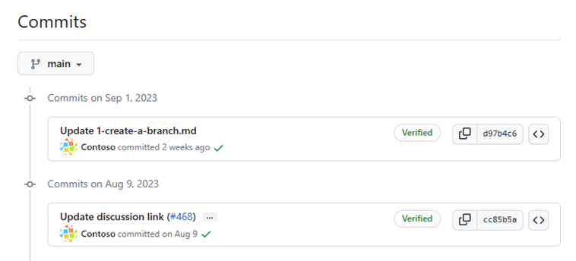
What are commits?
In the previous unit, you added a new file into the repository by pushing a commit. Let’s briefly review what commits are.
A commit is a change to one or more files on a branch. Every time a commit is created, it's assigned a unique ID and tracked along with the time and contributor. Commits provide a clear audit trail for anyone reviewing the history of a file or linked item, such as an issue or pull request.
Notes:
A commit is essentially a snapshot of changes you’ve made to one or more files on a branch, each tagged with a unique identifier, timestamp, and author information to form a clear audit trail.
When you create a commit—whether by adding a file in the web UI or running git commit locally—you’re moving modified files from the “staged” state into the repository’s history.

Slide 20
What are commits? (continued)
Within a git repository, a file can exist in several valid states as it goes through the version control process. The primary states for a file in a Git repository are Untracked and Tracked.
Untracked: An initial state of a file when it isn't yet part of the Git repository. Git is unaware of its existence.
Tracked: A tracked file is one that Git is actively monitoring. It can be in one of the following substates:
Unmodified: The file is tracked, but it hasn't been modified since the last commit.
Modified: The file has been changed since the last commit, but these changes aren't yet staged for the next commit.
Staged: The file has been modified, and the changes have been added to the staging area (also known as the index). These changes are ready to be committed.
Committed: The file is in the repository's database. It represents the latest committed version of the file.
These states and substates are important to collaborating with your team to know where each and every commit is in the process of your project. Now let’s move on to pull requests.
Notes:
Files in Git move through a series of states before and after they become part of a commit. Initially, new files are untracked—Git ignores them until you explicitly stage them.
Once you stage a file, it’s in the staged state, awaiting inclusion in your next commit.
After committing, the file enters the committed state, meaning its current contents live permanently in the repository’s history.
Between these, tracked files can be unmodified (no changes since the last commit) or modified (changes made but not yet staged).
By understanding these states—untracked → modified → staged → committed—you gain precise control over what goes into each commit, ensuring that your project’s history remains clear, meaningful, and easy to navigate for everyone on your team.

Slide 21
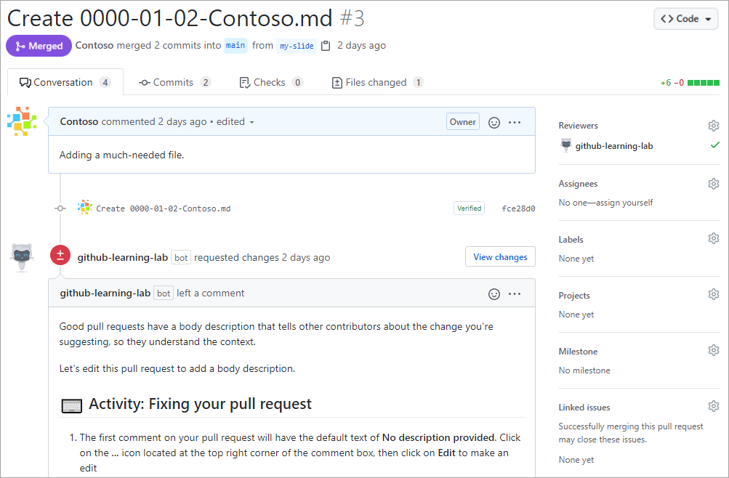
What are pull requests?
A pull request is the mechanism used to signal that the commits from one branch are ready to be merged into another branch.
The team member submitting the pull request asks one or more reviewers to verify the code and approve the merge. These reviewers have the opportunity to comment on changes, add their own, or use the pull request itself for further discussion.
Once the changes have been approved (if required), the pull request's source branch (the compare branch) is merged into the base branch.
Now that we know of all the ingredients, let’s review the GitHub flow.
Notes:
A pull request (often abbreviated “PR”) is GitHub’s built-in way of proposing, discussing, and ultimately integrating changes from one branch into another—typically from a feature or bug-fix branch into the main (default) branch.
When you open a pull request, you’re essentially saying, “I’ve finished my work on this branch; please review and merge it.”
GitHub then presents a unified view of all the commits you’ve made, highlights the exact lines of code that changed, and tracks the conversation thread around each change. Every pull request is assigned its own URL, can be linked to issues or other PRs, and maintains a clear audit trail of feedback, approvals, and automated checks.
Team members or designated reviewers are notified and can comment on specific lines, suggest additional commits, or even push their own changes directly to your branch (if you’ve granted them permission).
Most organizations configure continuous integration (CI) to automatically run tests, linters, or security scans against each pull request, gating the merge until all checks pass.
Once reviewers sign off—either through explicit approvals or by resolving requested changes—the pull request can be merged, bringing your commits into the base branch.
From there, GitHub updates the main codebase (and often triggers downstream workflows like deployments), closes out the PR, and records the merge event, giving everyone on the team a transparent, traceable record of who changed what, when, and why.

Slide 22
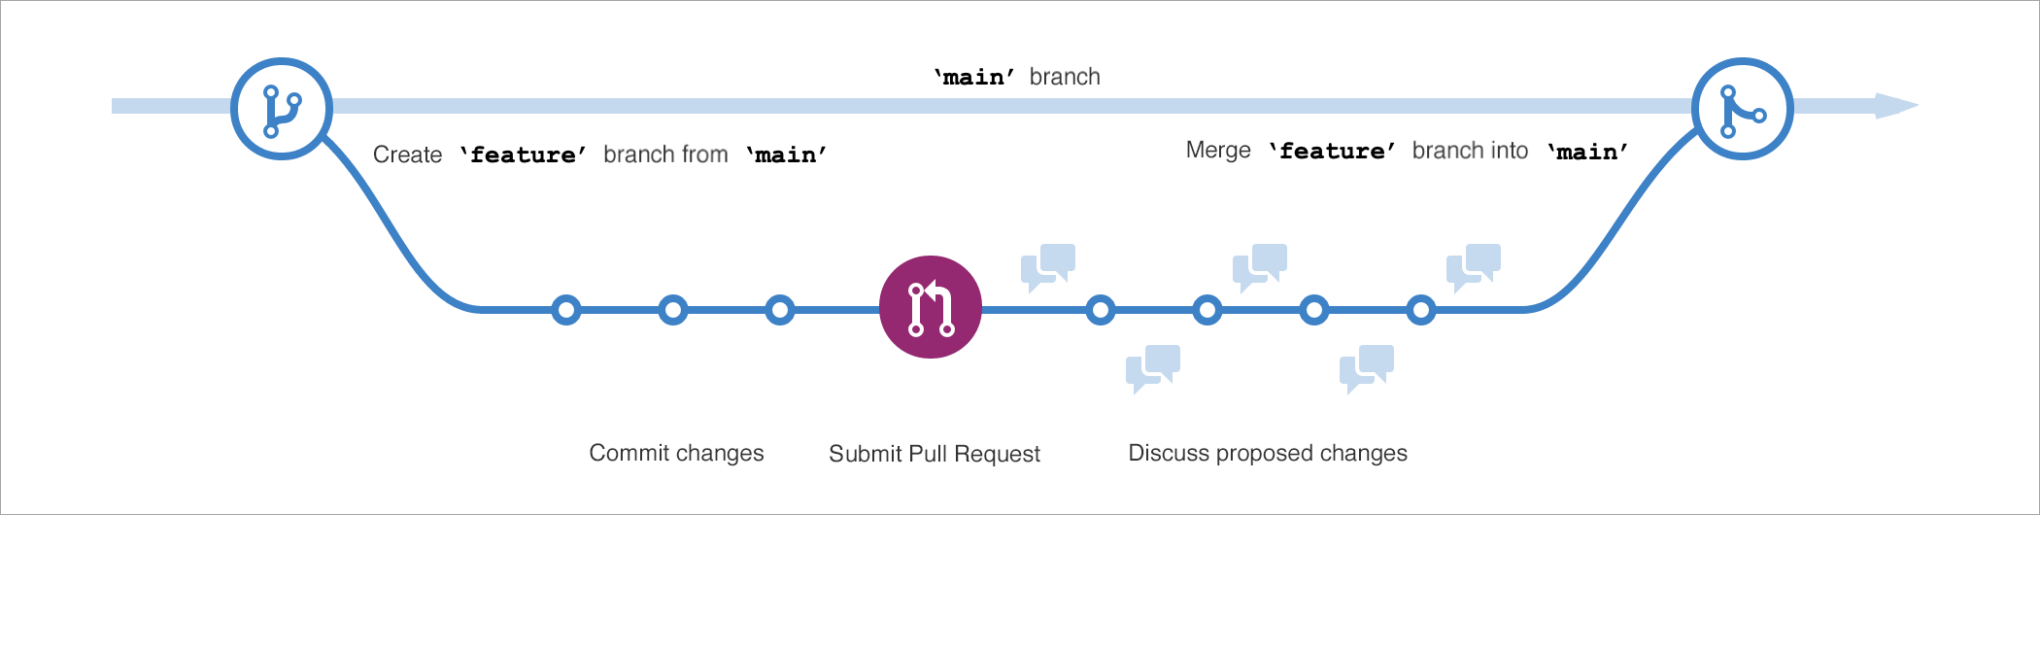
The GitHub Flow
The GitHub flow can be defined as a lightweight workflow that allows for safe experimentation. You can test new ideas and collaboration with your team by using branching, pull requests, and merging.
Now that we know the basics of GitHub we can walk through the GitHub flow and its components.
Notes:
We’ve covered branches, commits, and pull requests—now let’s see how they all come together in the GitHub Flow. At its heart, the GitHub Flow is a lightweight, repeatable process that lets you safely experiment, collaborate, and ship changes without ever destabilizing your main codebase.

Slide 23
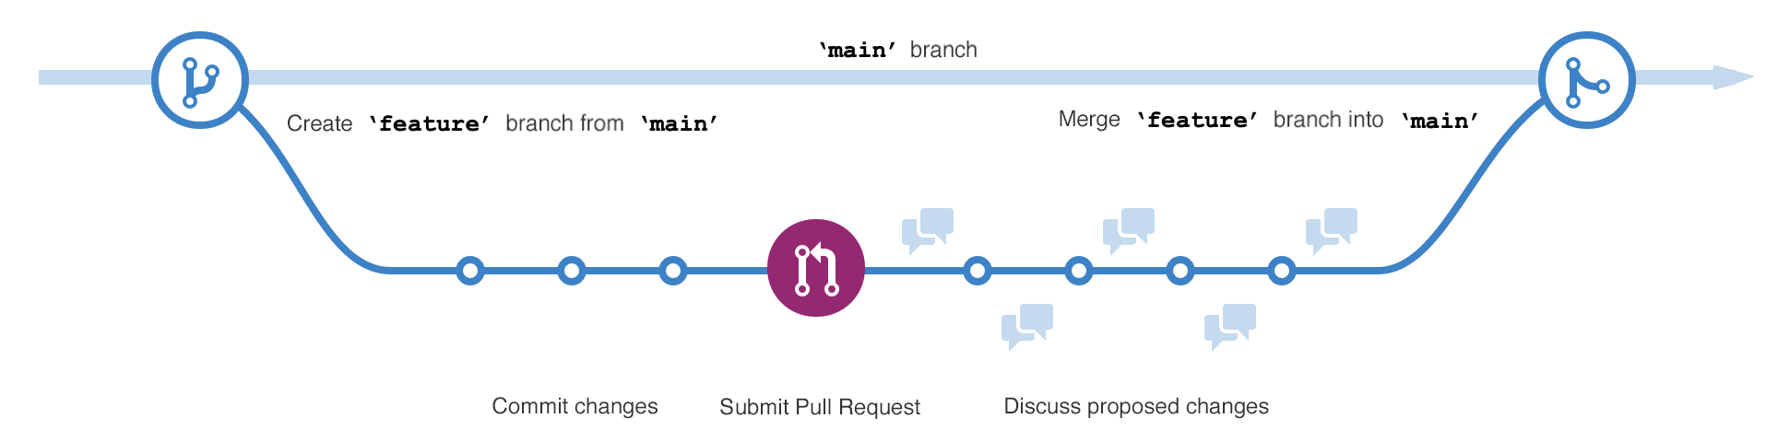
The GitHub Flow (continued)
Start by creating a branch so that the changes, features, and fixes you create don't affect the main branch.
Next, make your changes. We recommend deploying changes to your feature branch before merging into the main branch. Doing so ensures the changes are valid in a production environment.
Now, create a pull request to ask collaborators for feedback. Pull request review is so valuable that some repositories require an approving review before pull requests can be merged.
Then review and implement your feedback from your collaborators.
Once you feel great about your changes, it's time to get your pull request approved and merge it into the main branch.
Finally, you can delete your branch. Deleting your branch signals your work on the branch is complete and prevents you or others from accidentally using old branches.
Notes:
[Step 1: Create a Branch]
Start every new piece of work by creating a branch. This could be a bug fix, a new feature, or even a quick experiment. By keeping your changes on a separate branch, you ensure that the main branch remains deployable at all times. Think of your feature branch as your personal workspace—you can iterate as much as you need without affecting anyone else.
[Step 2: Make & Deploy Changes] Next, build and test on your branch. We recommend deploying your branch to a staging or preview environment before merging—this way you verify your work in a production-like setting. Seeing your changes live helps catch issues early, and gives you confidence that merging won’t introduce unexpected problems.
[Step 3: Open a Pull Request] When you’re ready for feedback, open a pull request. This signals to your teammates: ‘Hey, take a look at what I’ve done.’ GitHub will show exactly which lines changed, and you can link the PR to any related issue. Most teams even automate tests and code-quality checks to run against each PR, so you get instant feedback.
[Step 4: Review & Iterate] Reviewers can now comment on specific lines, request changes, or give a thumbs-up approval. Use this feedback loop to refine your work—push additional commits to the same branch, and GitHub will automatically update the pull request. This collaborative review process helps surface ideas, share knowledge, and maintain code quality.
[Step 5: Merge & Delete Branch] Once you have the green light—no failed checks, all reviews approved—it’s time to merge. Merging brings your commits into the main branch, triggering any downstream workflows like deployments. After merging, delete your branch. This keeps your repository tidy and prevents confusion over stale branches.
And that’s a full GitHub Flow cycle! You’ve created a safe sandbox, iterated with confidence, collaborated through pull requests, and shipped your changes—all while keeping main stable.
Next up, we’ll look at how issues and discussions further enhance collaboration by helping you track bugs, plan features, and share ideas.

Slide 24
GitHub is a collaborative platform
Collaboration is at the core of everything GitHub does. We went over repositories in the first unit of the module and learned that repositories help you organize your project and its files. In the last unit, we learned about pull requests, which is a way to keep track of changes made to your project.
Issues
GitHub Issues were created to track ideas, feedback, tasks, or bugs for work on GitHub. Issues can be created in various ways, so you can choose the most convenient method for your workflow.
For this walkthrough, we'll go over how to create an issue from a repository. But issues can also be created from:
An item in a task list.
A note in a project.
A comment in an issue or pull request.
A specific line of code.
A URL query.
Notes:
So far, we’ve covered how repositories help you organize your code and how pull requests let you propose and review changes.
Now, we’re going to explore two more core collaboration tools: Issues and Discussions.
These features give you structured ways to track work, share ideas, and drive conversations—whether you’re coordinating a small team or an open-source community.
Issues are GitHub’s built-in ticketing system—they help you capture and track everything from bug reports and feature requests to task lists and feedback. Each issue is a standalone discussion thread with its own title, description, labels, assignees, and milestones, so you can prioritize and assign work clearly.
You can create an issue directly from a repository’s Issues tab—or, if you prefer:
Turn a task list item into an issue
Convert a project note into an issue
Highlight a comment in another issue or PR
Select a specific line of code and open an issue from there
Even craft an issue via a URL query
No matter which route you choose, issues give your team a single, discoverable place to capture work and keep everyone aligned.

Slide 25
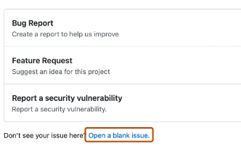
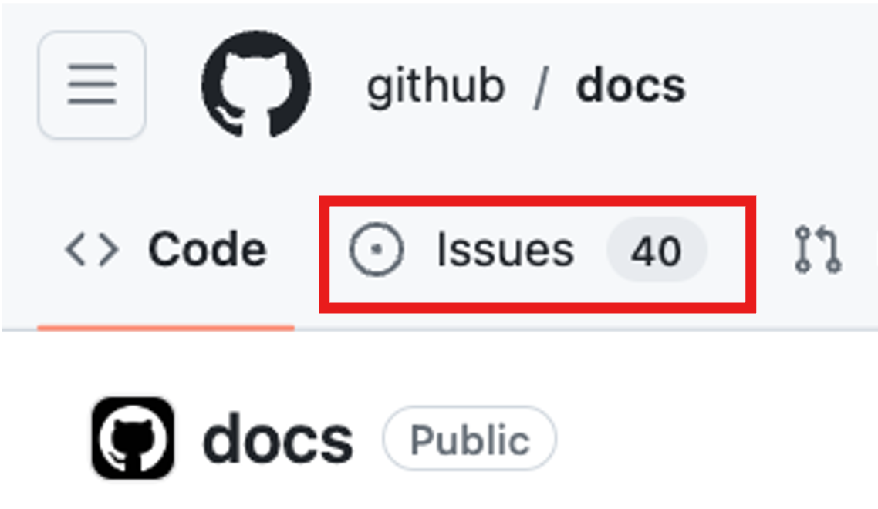
Creating an issue from a repository
Step 1
Step 3
On GitHub.com, navigate to the main page of the repository.
Select New issue.
Step 2
Step 4
Under your repository name, select Issues.
If your repository uses issue templates, next to the type of issue you'd like to open select Get started.
If the type of issue you'd like to open isn't included in the available options, select Open a blank issue. If not using templates, skip to Step 5.
Notes:
On GitHub.com, navigate to the main page of the repository.
Under your repository name, select Issues.
Select New issue.
If your repository uses issue templates, next to the type of issue you'd like to open select Get started.
If the type of issue you'd like to open isn't included in the available options, select Open a blank issue. If not using templates, skip to Step 5.

Slide 26
Creating an issue from a repository (continued)
Step 5
Step 7
In the Add a title field, enter a title for your issue.
If you're a project maintainer, you can assign the issue to someone, add it to a project board, associate it with a milestone, or apply a label.
Step 6
Step 8
In the Add a description field, type a description of your issue.
When you're finished, select Submit new issue.
Some conversations are more suitable for GitHub Discussions. You can use GitHub Discussions to ask and answer questions, share information, make announcements, and conduct or participate in conversations about a project.
In the next section, we’ll review Discussions and how to best utilize the feature.
Notes:
In the Add a title field, enter a title for your issue.
In the Add a description field, type a description of your issue.
If you're a project maintainer, you can assign the issue to someone, add it to a project board, associate it with a milestone, or apply a label.
When you're finished, select Submit new issue.
Some conversations are more suitable for GitHub Discussions.
You can use GitHub Discussions to ask and answer questions, share information, make announcements, and conduct or participate in conversations about a project.
In the next section, we’ll review Discussions and how to best utilize the feature.

Slide 27
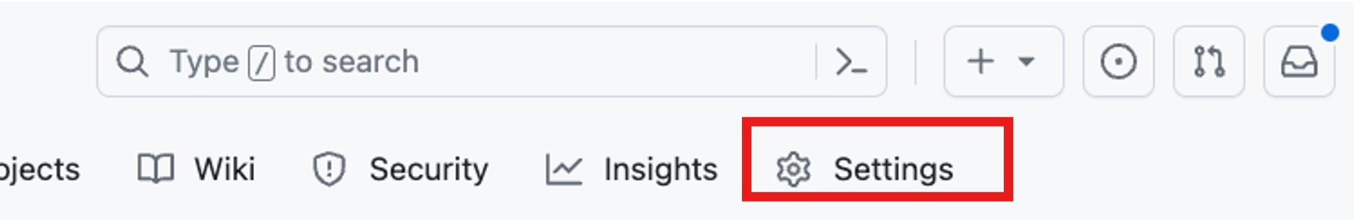
Discussions
Discussions are for conversations that need to be accessible to everyone and aren't related to code. Discussions enable fluid, open conversation in a public forum.
Enabling a discussion in your repository
Repository owners and people with Write access can enable GitHub Discussions for a community on their public and private repositories. The visibility of a discussion is inherited from the repository the discussion is created in.
When you first enable GitHub Discussions, you're invited to configure a welcome post.
Step 1
Step 2
On GitHub.com, navigate to the main page of the repository.
Under your repository name, select Settings.
Notes:
To bring the power of open dialogue into your project, you’ll first need to turn on Discussions in your repository settings.
Let’s enable a discussion in your repository:
On GitHub.com, navigate to the main page of the repository.
Under your repository name, select Settings.

Slide 28
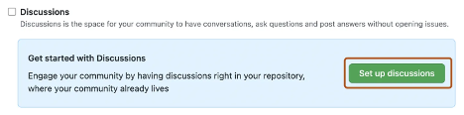
Enabling a discussion in your repository (continued)
Step 3
Step 4
Scroll down to the Features section and under Discussions, select Setup discussions.
Under Start a new discussion, edit the template to align with the resources and tone you want to set for your community.
Step 5
Select Start discussion.
Notes:
Scroll down to the Features section and under Discussions, select Setup discussions.
Under Start a new discussion, edit the template to align with the resources and tone you want to set for your community.
Select Start discussion.

Slide 29
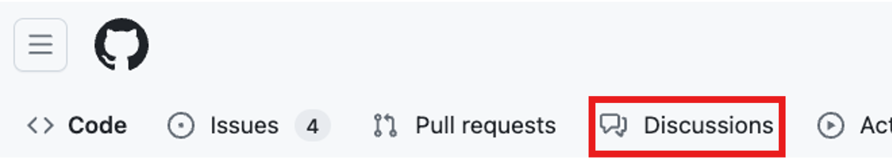
Create a new discussion
Any authenticated user who can view the repository can create a discussion in that repository. Similarly, since organization discussions are based on a source repository, any authenticated user who can view the source repository can create a discussion in that organization.
Step 1
Step 2
On GitHub.com, navigate to the main page of the repository or organization where you want to start a discussion.
Under your repository or organization name, select Discussions.
Notes:
When you’re ready to start a conversation, head over to the Discussions tab and choose a category that best fits your purpose.
On GitHub.com, navigate to the main page of the repository or organization where you want to start a discussion.
Under your repository or organization name, select Discussions.

Slide 30
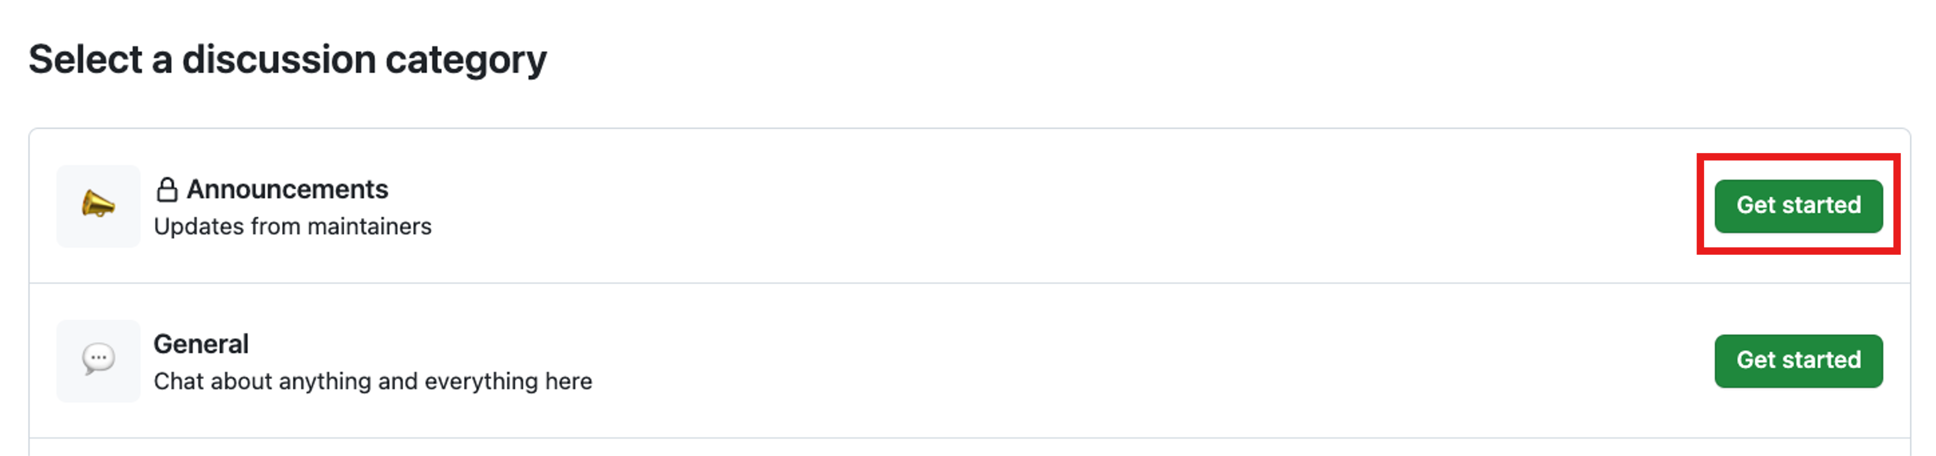
Create a new discussion (continued)
Step 3
On the right side of the page, select New discussion.
Step 4
Select a discussion category by selecting Get started. All discussions must be created in a category. For repository discussions, people with maintain or admin permissions to the repository define the categories for discussions in that repository.
Notes:
On the right side of the page, select New discussion.
Select a discussion category by selecting Get started. All discussions must be created in a category. For repository discussions, people with maintain or admin permissions to the repository define the categories for discussions in that repository.

Slide 31
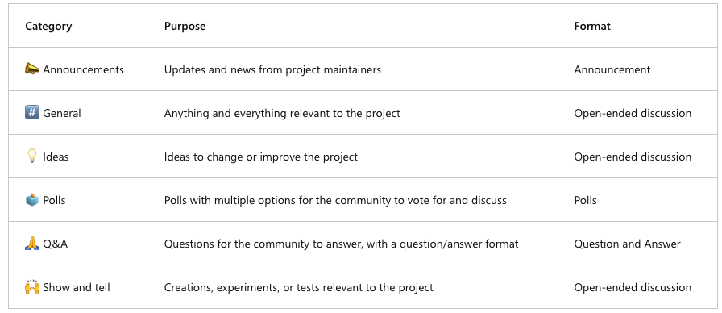
Categorize discussions
Each category must have a unique name, emoji pairing, and a detailed description stating its purpose. Categories help maintainers organize how conversations are filed. They're customizable to help distinguish categories that are Q&A or more open-ended conversations.
The following table shows the default categories for discussions and their purpose.
Notes:
Every lively community needs structure, and GitHub Discussions delivers just that with customizable categories.
Think of each category as a filing folder—complete with a unique emoji, name, and a description that explains its role.
This makes it instantly clear where each conversation belongs, whether it’s a quick question, a design brainstorm, or a project update.
GitHub ships with six default categories that cover most collaborative needs:
📣 Announcements for maintainer updates and news
#️⃣ General for any open-ended project chatter
💡 Ideas to capture improvement suggestions
🗳️ Polls whenever you want the community to vote
🙏 Q&A for clear question-and-answer threads
🙌 Show and tell to showcase experiments or project highlights

Slide 32
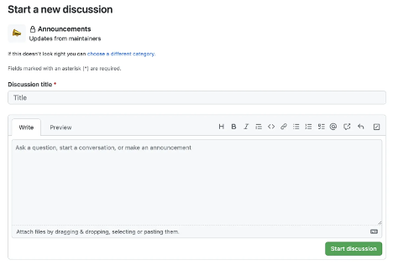
Categorize discussions (continued)
Step 1
Step 2
Under Discussion title enter a title for your discussion, and under Write enter the body of your discussion.
Select Start discussion.
Notes:
Under Discussion title enter a title for your discussion, and under Write enter the body of your discussion.
Select Start discussion.
That covers a little about how GitHub inspires collaboration.
Now let's move to how you can manage notifications, subscribe to threads, and get started with GitHub pages.

Slide 33
GitHub platform management
Now that you know the basics of the GitHub platform, let’s go over some platform management.
Managing notifications and subscriptions
You can choose to receive ongoing updates about specific activity on GitHub.com through a subscription. Notifications are the updates that you receive for specific activity to which you're subscribed.
Subscription options 🔔
You can choose to subscribe to notifications for:
A conversation in a specific issue, pull request, or gist.
CI activity, such as the status of workflows in repositories set up with GitHub Actions.
Repository issues, pull requests, releases, security alerts, or discussions (if enabled).
All activity in a repository.
Notes:
GitHub lets you subscribe to any thread—whether it’s an issue, pull request, discussion, or even a single gist.
By customizing your notification settings at the repository or organization level, you can choose to watch all conversations, ignore repositories you don’t actively work on, or cherry-pick individual threads.
If you want ongoing updates on a discussion, you can subscribe directly from any issue or pull request—even a single line of code can become its own thread.
You can choose to subscribe to notifications for:
A conversation in a specific issue, pull request, or gist.
CI activity, such as the status of workflows in repositories set up with GitHub Actions.
Repository issues, pull requests, releases, security alerts, or discussions (if enabled).
All activity in a repository.

Slide 34
Managing notifications and subscriptions
In some instances, you're automatically subscribed to conversations on GitHub. Examples include opening a pull request or issue, commenting on a thread, or being assigned to an issue or pull request.
If you're no longer interested in a conversation, you can unsubscribe, unwatch, or customize the types of notifications you'll receive in the future.
If you're ever interested in issues that mention a certain user, you can use mentions: as the qualifier to find those specific issues.
Notes:
In some instances, you're automatically subscribed to conversations on GitHub. Examples include opening a pull request or issue, commenting on a thread, or being assigned to an issue or pull request.
If you're no longer interested in a conversation, you can unsubscribe, unwatch, or customize the types of notifications you'll receive in the future.
If you're ever interested in issues that mention a certain user, you can use mentions: as the qualifier to find those specific issues.

Slide 35
What are GitHub Pages?
To round out our journey of GitHub, let’s tackle GitHub pages. You can use GitHub Pages to publicize and host a website about yourself, your organization, or your project directly from a repository on GitHub.com.
GitHub Pages is a static site-hosting service that takes HTML, CSS, and JavaScript files straight from a repository on GitHub. Optionally, you can run the files through a build process and publish a website. Edit and push your changes, and your project is live for the public in a visually organized way.
Notes:
As we round out our tour of GitHub’s collaboration and content tools, let’s talk about GitHub Pages—a built-in static site hosting service that turns any repository into a live website. Whether you want a personal portfolio, project documentation site, or an organization landing page, GitHub Pages makes it easy: you simply add your HTML, CSS, and JavaScript (or Markdown files that Jekyll can build), push to a designated branch, and—your site is published.
What makes Pages so powerful is the seamless workflow: every time you edit and push changes to your repo, GitHub automatically rebuilds and deploys the site. This means your documentation, demos, or blog posts stay in sync with your code—no separate deployment pipeline required. And because it’s all managed through Git, you get version history, pull-request–driven updates, and collaborative editing out of the box.
Up until now, you’ve explored GitHub’s core capabilities—from spinning up repositories and working through the GitHub Flow, to collaborating via issues, discussions, and even publishing with GitHub Pages.
Now it’s time to put all of that into action with our first exercise.

Slide 36

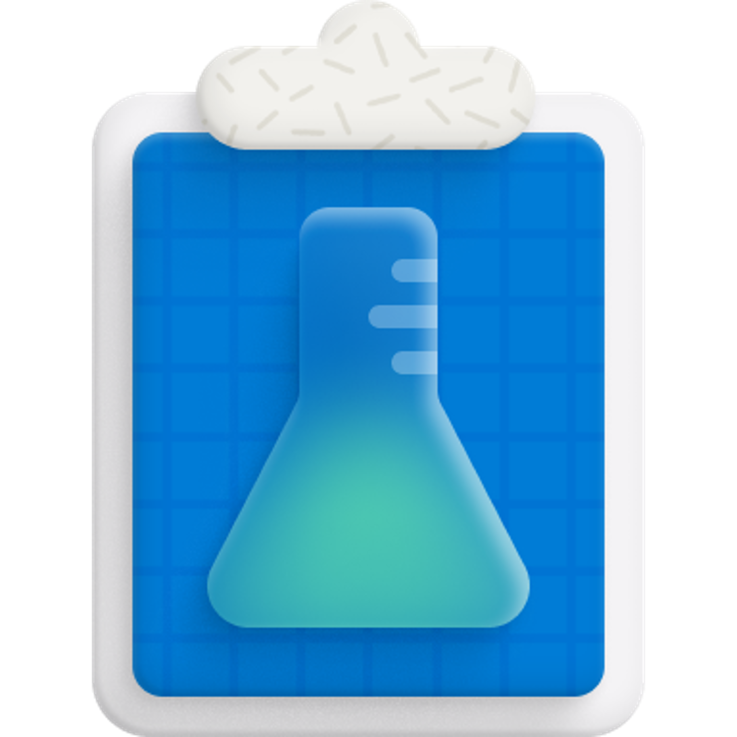
Exercise - A guided tour of GitHub
When you select the Start the exercise on GitHub button below, you'll be navigated to a public GitHub template repository that prompts you to complete a series of small challenges.
When you've finished the exercise in GitHub, return here for:
A quick knowledge check.
A summary of what you've learned.
A badge for completing this module.
Note: You don't need to modify any of the workflow files to complete this exercise. Altering the contents in this workflow can break the exercise's ability to validate your actions, provide feedback, or grade the results.
Start the exercise on GitHub.
Notes:
Now it’s your turn to put everything we’ve covered into practice with a hands-on exercise.
When you click Start the exercise on GitHub, you’ll land in a ready-to-use template repository that walks you through the core tasks: creating branches, committing files, opening pull requests, and merging them. This guided tour is designed to reinforce your understanding of the GitHub Flow in a safe, self-checking environment.
As you work through each challenge, you’ll see in-browser feedback to let you know when you’ve successfully completed an action.
Don’t worry about the underlying workflow files—they’re set up to validate your steps automatically, so you can focus on the tasks themselves. When you’ve finished, come back here, and we’ll do a quick knowledge check together, recap the highlights of the module, and award you a badge for conquering this exercise.
Enjoy exploring GitHub, and don’t hesitate to pause and revisit any section if you need a refresher!

Slide 37
Knowledge Checks
Notes:
Congratulations on making it to the end of the module! Now it’s time to put your knowledge to the test with a short, three-question assessment.
This is your opportunity to reinforce what you’ve learned about reporting issues, working with branches and pull requests, and contributing to projects when you don’t have direct write access.
Read each question carefully, select the response that most closely matches best practices on GitHub, and trust your instincts—let’s see how well you’ve absorbed the GitHub Flow!

Slide 38
Knowledge Check: Introduction to GitHub
1 of 3
What is the best way to report a bug to a GitHub project?
Send an email to a project owner.
I don't bother reporting software bugs because there's no transparency, and they never get fixed anyway.
Search for the bug in the project's existing issues, and create a new one if it hasn't been reported yet.
© Copyright Microsoft Corporation. All rights reserved.
Notes:
What is the best way to report a bug to a GitHub project?
Send an email to a project owner. Explanation: This hides the issue from the wider community and doesn’t leverage the project’s public issue tracker.
I don’t bother reporting software bugs because there’s no transparency… Explanation: Skipping the official process prevents collaboration and feedback, and assumes issues won’t be addressed.
Search for the bug in the project’s existing issues, and create a new one if it hasn’t been reported yet. Explanation: This avoids duplicate reports, uses the project’s public issue system, and invites community input.
Correct answer C: Search for the bug in the project’s existing issues, and create a new one if it hasn’t been reported yet.

Slide 39
Knowledge Check: Introduction to GitHub
2 of 3
Suppose you created a bug fix on a new branch and want it to become part of the next production build generated from the main branch. What should you do next?
Copy your branch changes and commit them directly to the main branch.
Create a pull request to merge your new branch into the main branch.
On second thought, maybe I won't share this fix. I'll just put it in my own private version of the source code.
© Copyright Microsoft Corporation. All rights reserved.
Notes:
Suppose you created a bug fix on a new branch and want it to become part of the next production build generated from the main branch. What should you do next?
Copy your branch changes and commit them directly to the main branch. Explanation: Committing directly to the main branch bypasses code review and risks destabilizing the production code.
Create a pull request to merge your new branch into the main branch. Explanation: A pull request enables review, automated checks, and safe integration of your changes.
On second thought, maybe I won’t share this fix… Explanation: Keeping fixes private prevents the broader project from benefiting and undermines collaboration.
Correct answer B: Create a pull request to merge your new branch into the main branch.

Slide 40
Knowledge Check: Introduction to GitHub
3 of 3
Suppose you'd like to work with a project on GitHub, but you don't have write access to the project. What can you do to contribute?
Fork the project's repository to your GitHub account, clone the forked repository to your local machine, push changes to your repository, and submit a pull request to the target (upstream) repository.
Clone the project to your local machine and push updates directly to the project repository.
Use git commands to make a copy of the project so that you can work locally. Submit an issue to get your changes into the target repository.
© Copyright Microsoft Corporation. All rights reserved.
Notes:
Suppose you’d like to work with a project on GitHub, but you don’t have write access to the project. What can you do to contribute?
Fork the project’s repository to your GitHub account, clone the forked repository… and submit a pull request to the target (upstream) repository. Explanation: Forking and submitting a pull request is the standard workflow for contributing without direct write permissions.
Clone the project to your local machine and push updates directly to the project repository. Explanation: You can’t push directly without write access, so this will be rejected by GitHub.
Use git commands to make a copy of the project so you can work locally. Submit an issue to get your changes into the target repository. Explanation: Filing an issue alone doesn’t include code changes; you still need to fork and submit a pull request for actual contributions.
Correct answer A: Fork the project’s repository to your GitHub account, clone the forked repository to your local machine, push changes to your repository, and submit a pull request to the target (upstream) repository.

Slide 41
Summary
In this module, you:
Identified the fundamental features of GitHub.
Learned about repository management.
Gained an understanding of the GitHub flow including branches, commits, and pull requests.
Explored the collaborative features of GitHub by reviewing issues and discussions.
Recognized how to manage your GitHub notifications and subscriptions.
Now that you're familiar with the basics of GitHub, learn to Upload your project by using GitHub best practices.
Learn more
Here are some links to more information on the topics we discussed in this module.
Set up Git
Repositories documentation
Creating gists
About wikis
Quickstart for GitHub Discussions
Configuring notifications
GitHub Pages documentation
About branches
About commits
About pull requests
About issues
Notes:
We’ve covered a lot of ground in this module.
First, you learned the fundamental features of GitHub—what makes it a powerful, AI-enabled platform built on Git.
Then, we dove into repository management: creating repos, adding files, and organizing your work.
We walked through the GitHub Flow—branches for safe experimentation, commits as your project history, and pull requests to collaborate and merge changes.
Next, we explored GitHub’s collaborative tools—Issues for tracking work, Discussions for open-ended conversations, and the notifications and subscriptions that help you stay in the loop.
By the end, you knew how to tailor GitHub to your team’s workflow, keeping both code and conversation clear and connected.
Now that you’re comfortable with the basics, you’re ready to take your project to the next level.
I encourage you to explore best practices for uploading and structuring your code, automating workflows with GitHub Actions, and securing your repositories with advanced features like code scanning and Dependabot.
Below are some resources to deepen your knowledge—feel free to bookmark them and refer back as you continue your GitHub journey.

